Slide 1

Education Support Staff · Session 5
Working in Partnership
Notes:
SUGGESTED TIME: 1 min · 2:15 - 2:16
PURPOSE
Open the partnership session and connect it to the support design work in Session 4.
WHAT TO DO
1. Name the shift from the support you help deliver to how the people around the student understand and act together.
2. Pick up the last line of the Session 4 commit: "What will you talk to the teacher about?", and the "I will talk with" line on the 'My students' card.
3. Keep the student at the centre of the conversation.
4. Acknowledge that participants may bring both productive and difficult partnership experiences, with families and with colleagues.
5. Remind the room that sharing is voluntary and examples stay anonymised (initials or roles only).
KEY MESSAGES
• Partnership is part of understanding and support, not an additional task after decisions are made.
• The student, family, teacher and support staff may each hold different parts of the picture.
THREAD
Picks up the Session 4 commit ("What will you talk to the teacher about?") and the "I will talk with" line on the 'My students' card (Participant Guide p. 21).

Slide 2
Working in partnership
Family
School staff
What is the goal of these intersecting partnerships?
Every partner brings different knowledge and a different relationship with the student.
The student is at the centre of every partnership.
Student
Support staff
Notes:
SUGGESTED TIME: 3 min · 2:16 - 2:19 · Participant Guide p.22 - Session 5 summary
PURPOSE
Show where the partnerships around a student intersect, with the student at the centre of every one.
WHAT TO DO
1. Introduce the Venn: family, school staff and support staff, with the student at the centre.
2. Name that support staff are the people in this room. Support staff often hold the closest hour-by-hour view of a student's day, across every room and space.
3. Explain that every partner brings different knowledge and a different relationship with the student and with each other.
4. Ask the group: What is the goal of these intersecting partnerships? Take 2-3 responses.
5. Steer the discussion so the point is made that the student is at the centre of all partnerships.
6. Ask who is missing from the picture and how the student's communication can be included.
7. Point participants to Where partnerships converge in the Participant Guide (p. 22).
YOU MIGHT SAY
What is the goal of these intersecting partnerships?
KEY MESSAGES
• Positive partnership keeps the student at the centre.
• No single person holds the complete picture.
• Every partner brings different knowledge and a different relationship with the student.
• Support staff knowledge of the student's day is part of that picture.
KEEP IN MIND
• Use the elements as discussion prompts rather than a complete definition.
BACKGROUND
With session time limited, this slide is a chance to see where all the partnerships converge and what is needed for success across all of them.
THREAD
Draws on Autistic experience (Sessions 2 and 3) and the Session 4 support design and ladder.

Slide 3

Building a home-school partnership
Parents and families are the first and continuing educators of their children
Learning is lifelong and occurs in multiple settings
Partnerships, schools and school communities flourish when the diversity and strengths of families are valued and leveraged
Community engagement expands responsibility and resources
Partnerships grow from mutual trust, respect and responsibility
Partnerships need committed, collaborative and creative leadership
Family-School Partnerships Framework, Department of Education, 2020
Notes:
SUGGESTED TIME: 2 min · 2:19 - 2:21
PURPOSE
Make positive partnership concrete in everyday practice using the Family-School Partnerships Framework principles.
WHAT TO DO
1. Walk through the six Framework principles briefly.
2. Position family knowledge and school knowledge as different, useful perspectives.
3. Name what makes partnership visible in practice: a shared purpose, respectful listening, student voice and communication, clear accessible information, and agreed next steps, responsibilities and follow-up.
4. Note that support staff are often part of the everyday contact that builds this trust: drop-off, pick-up, the playground, the bus bay.
KEY MESSAGES
• The student, family and school may each see different parts of experience. Partnership helps these perspectives inform understanding, design, action and review from the beginning.
• Listening, clarity and shared next steps can be observed in practice.
KEEP IN MIND
• Avoid implying that agreement is required before listening or respect are possible.
RESOURCES
Family-School Partnerships Framework - Department of Education, Australian Government - https://www.education.gov.au/supporting-family-school-community-partnerships-learning/family-school-partnerships/family-school-partnerships-framework

Slide 4
What is effective collaboration?
Shared goals
Seeing other perspectives
Shared values
Invite curiosity: How could we work together for better learning outcomes?
Mutual trust and respect
Centring student voice
Consult on decision-making
Assume good intent
Notes:
SUGGESTED TIME: 3 min · 2:21 - 2:24
PURPOSE
Name the collaboration principles that strong partnerships share, whoever is at the table.
WHAT TO DO
1. Introduce the importance of collaboration: for Autistic students there are many collaboration points across many partnerships, and support staff sit in several of them.
2. Explain that the key collaboration skills are the same across all groups, including between support staff and teachers.
3. Ask the group: What are some of the key principles for effective collaboration to occur?
4. Build the discussion to cover: shared goals, shared values, mutual trust and respect, consulting on decision-making, seeing other perspectives, inviting curiosity, centring student voice, assuming good intent.
5. Click to reveal the points on the slide once the room has contributed.
YOU MIGHT SAY
What are some of the key principles for effective collaboration to occur?
How could we work together for better learning outcomes?
KEY MESSAGES
• The collaboration skills needed are the same across every partnership around the student, including the working relationship with the teacher.
BACKGROUND
This slide works well with all parties and helps shift perspectives.
THREAD
Leads into the next slide: a communication rhythm with the teacher.

Slide 5
A communication rhythm with the teacher
Short, regular and planned works better than catching up when something goes wrong.
Regular
A few minutes at a set time, even once a week.
Brief and planned
What you saw, what helped, and one question.
The teacher’s plan
Work from the teacher’s plan for the lesson and the student.
No plan yet?
Ask: 'What should I know to support them well?' and agree a first step.
You help deliver adjustments. The teacher plans them with you.
Notes:
SUGGESTED TIME: 4 min · 2:24 - 2:28 · Participant Guide p.22 - Session 5 summary
PURPOSE
Build a regular, brief and planned communication rhythm with the teacher, working from the teacher's plan.
WHAT TO DO
1. Direct people to the slide and read the top line: short, regular and planned works better than catching up when something goes wrong.
2. Walk through the four cards.
3. Regular: a few minutes at a set time, even once a week. Primary example: five minutes at the end of a set lesson each week. Secondary example: a quick check with a subject teacher at the start of a set lesson.
4. Brief and planned: what you saw, what helped, and one question. Keep what you saw separate from what you think it means.
5. The teacher's plan: work from the teacher's plan for the lesson and the student.
6. No plan yet: pause before making up a new support. Ask: 'What should I know to support them well?' and agree a first step.
7. Give 1 minute: note one realistic time in your week for a check-in, and one question you would bring to it.
8. Read the bottom line aloud.
YOU MIGHT SAY
What should I know to support them well?
You help deliver adjustments. The teacher plans them with you.
KEY MESSAGES
• A short, planned rhythm is more useful than waiting for a problem or relying on a rushed chat in the doorway.
• Specific observations help the teacher plan.
• No plan yet is a reason to ask and agree a first step, not to change the approach alone.
• You help deliver adjustments. The teacher plans them with you.
KEEP IN MIND
• Time for this is not always built into support staff hours. Acknowledge that, and keep the rhythm to what is realistic.
• In secondary settings, support staff may work with many teachers. Suggest starting with one.
• Keep the tone collegial: a missing plan is a reason to ask, not a criticism of the teacher.
THREAD
Builds on the Session 4 commit ("What will you talk to the teacher about?"). The Session 6 action card asks participants to share one thing with the teacher they work with.

Slide 6
When families tell you first
Families often trust support staff first. You see them at drop-off, pick-up or the bus bay, and you know the student.
Community roles
In First Nations communities especially, support staff are often a key link for families and teachers.
Know your pathway
Know how concerns are passed on, and what should never sit with you alone.
The warm handover
'That matters. Can we bring the teacher into this together?'
Keep the trust
Tell the family what will happen next, and follow up.
The trust families place in you is a strength. Your school’s pathway helps you use it well.
Notes:
SUGGESTED TIME: 6 min · 2:28 - 2:34 · Participant Guide p.22 - Session 5 summary
PURPOSE
Recognise that families often trust support staff first, and practise receiving what they share and bringing the teacher in through the school's pathway.
WHAT TO DO
1. Read the top line: families often trust support staff first. You see them at drop-off, pick-up or the bus bay, and you know the student.
2. Ask: Where do families talk to you? Take 2-3 responses (for example the gate, pick-up, the playground, the bus bay, the community).
3. Community roles: say this directly and give it time. In First Nations communities especially, support staff are often a key link for families and teachers. That link is part of how the school works well for those families and students.
4. If Aboriginal and Torres Strait Islander education officers or other staff in the room want to add to this, make space. Do not ask anyone to speak for their community.
5. Know your pathway: ask participants to think about how concerns are passed on in their school, and what should never sit with them alone. Anything that raises a safety concern follows the school's child protection procedures straight away.
6. The warm handover: read the sentence, then ask the room to say it aloud together or to the person next to them.
7. Keep the trust: tell the family what will happen next, and follow up.
8. Give 1 minute: note who you would go to first in your school, and one part of the pathway you need to check.
9. Read the bottom line aloud.
YOU MIGHT SAY
That matters. Can we bring the teacher into this together?
KEY MESSAGES
• The trust families place in support staff is a strength. The school's pathway helps you use it well.
• Receive what the family shares, acknowledge it, and bring the teacher in. You do not have to carry it alone.
• Tell the family what will happen next, and follow up.
• In First Nations communities especially, support staff are often a key link for families and teachers.
KEEP IN MIND
• Never frame a family's trust in support staff as a problem. It is something the school should value and build on.
• Do not generalise about First Nations families, communities, staff roles or protocols. Follow local, culturally informed guidance.
• Do not invite real family stories or identifiable details. Use general or made-up examples.
• Do not promise families an outcome or confidentiality you cannot keep.
• Keep to what support staff need to know to do their role. Participants should not go looking for more information than the family offers.
BACKGROUND
The First Nations point is meant to be delivered with weight, not as an aside. Information-sharing and child protection pathways differ between schools and systems, so the slide asks participants to know their own pathway rather than teaching one.
THREAD
The bridge activity (slide 19) and the Session 6 conversation plan can include bringing the teacher into a family conversation.

Slide 7

Power dynamics
Power can sit in:
Student
Socio-economic status
Historical / cultural experiences of education
Speaking English vs speaking a language other than English
Pedagogy / understanding of school systems and curriculum
Home
School
Perception of the importance / experience of school
Notes:
SUGGESTED TIME: 2 min · 2:34 - 2:36
PURPOSE
Help participants notice how agendas, language, authority and decision-making shape consultation.
WHAT TO DO
1. Introduce the seesaw: school, home and the student.
2. Name where power can sit: socio-economic status, historical and cultural experiences of education, speaking English or another language, understanding of school systems and curriculum, and perceptions of the importance of school.
3. Name that support staff can see power from both sides: families may see them as part of the school, and inside the school they may have less say in decisions.
4. Ask the power questions below to examine practice, not to blame individual participants.
YOU MIGHT SAY
Who sets the agenda?
Whose knowledge is heard?
Who can make decisions?
Is the student included in a way that works for them?
What could the school change about the process?
KEY MESSAGES
• Power is present in meeting structures, language and decision pathways.
• Support staff may notice power imbalances that others miss.
KEEP IN MIND
• Avoid describing a family as difficult, disengaged or unrealistic without examining the context and process.

Slide 8
Power dynamics activity
On Post-it notes:
1
Write an example of an imbalance in power dynamics from a home perspective.
2
Write an example of an imbalance in power dynamics from a school perspective.
3
Write how you could address these imbalances.
Share at your table, or add your notes to the wall under Home, School and Solutions.
6 minutes
Notes:
SUGGESTED TIME: 6 min · 2:36 - 2:42 · Participant Guide p.23 - Power dynamics
PURPOSE
Prompt participants to reflect on perceived and real power imbalances in the home-school relationship.
WHAT TO DO
1. Make sure every participant has Post-it notes and a pen.
2. Direct participants to the three instructions on the slide.
3. Choose a sharing option that suits the room (see steps).
4. Support tables to look for solutions rather than place blame.
5. Take feedback from a few participants at the end.
KEY MESSAGES
• Power can be structural, historical, cultural, conscious and unconscious.
• Status can be perceived as an imbalanced power dynamic, regardless of intent.
ACTIVITY: Post-it note reflection · table groups · 6 minutes
Prompt: Where do power imbalances sit in the home-school relationship, and how could you address them?
1. On one Post-it, write an example of an imbalance in power dynamics from a home perspective.
2. On a second, write an example from a school perspective.
3. On a third, write how you could address these imbalances.
4. Option 1: share Post-it notes with your table.
5. Option 2 (movement break): take your Post-it notes to another person in the room to share.
6. Option 3: place Post-it notes on butcher's paper on the wall under Home, School and Solutions.
Bring the room back:
• Who sets the agenda?
• Whose knowledge is heard?
• Who can make decisions?
• What could the school change about the process?
Close: Ask participants to keep one process change for their conversation plan.
KEEP IN MIND
• This may be challenging for some participants, who may have found themselves in positions of power or lack of power at different times in their work, including within the school. Guide individuals to seek solutions and not place blame.
BACKGROUND
Educators are immersed in the culture of education, including a shared understanding of acronyms (e.g. NAPLAN, NCCD, IEP) which families may not be able to access as easily. Some people will purposely and naturally endow teachers with higher status, which can be a cultural or personal attitude. External providers and professionals can also affect the power dynamic between those working with and supporting Autistic students. Support staff may be seen by families as closer to them than other school staff, which can make them a bridge.
THREAD
The process change chosen here carries into the bridge reflection (slide 19) and the Session 6 conversation plan.

Slide 9

Student voice
What decisions were made, and who made them?
What impact did those decisions have on Adon?
Notes:
SUGGESTED TIME: 5 min · 2:42 - 2:47 · Participant Guide p.23 - Student voice
PURPOSE
Show what happens when a student is not listened to or consulted.
WHAT TO DO
1. Introduce the video as an example of a student who is not listened to or consulted.
2. Ask participants, while watching, to pay attention to what decisions were made and who made them.
3. Play the video.
4. Ask the group: What impact did those decisions have on Adon?
5. Connect to the students participants support: how are their preferences asked and heard? Support staff often hear a student's preferences during the day. How do those reach the teacher?
YOU MIGHT SAY
While watching, pay attention to what decisions were made and who made them.
What impact did those decisions have on Adon?
KEY MESSAGES
• Students should have a say in decisions about them, at their level and in the way they communicate.
• Even young children can show preferences: choices offered visually, reactions observed and honoured.
• Ask students in a way that works for them: what helps? what's hard? what should staff know?
• Pass on what students tell you in their own words, so the student's view is part of the record.
• This is an early step in building self-advocacy.

Slide 10
Partnership activity
For each partner: what do they bring, and what challenges might they face?
Student
Parents and carers
Teachers
Support staff
Brings
Brings
Brings
Brings
Challenges
Challenges
Challenges
Challenges
8 minutes
Then compare: what do all four have in common?
Notes:
SUGGESTED TIME: 8 min · 2:47 - 2:55 · Participant Guide p.24 - Partnership activity
PURPOSE
Compare what each partner brings and the challenges they may face, and find what they share.
WHAT TO DO
1. Make sure each table has the Partnership activity grid in the Participant Guide (p. 24).
2. Ask table groups to record what each partner brings and what challenges they might face: student, parents and carers, teachers, support staff.
3. Name that the support staff are the people in this room. Ask tables to give that row the same care as the others, and to be specific about what they bring.
4. If a table is stuck on the Support staff row, prompt: the hour-by-hour view of the student's day, relationships with the student and often the family, knowledge of what works across settings, and the trust families place in them.
5. Ask tables to compare: what do all four have in common?
6. Take thoughts on similarities and differences, list the commonalities, and ask what would make the partnership more successful.
KEY MESSAGES
• Understanding the challenges and strengths of each partner can help build trust and confidence in the relationship.
• There are similarities and differences between what each partner brings to the partnership.
• Support staff bring knowledge no one else in the partnership holds.
• Everyone has the student at the centre and student voice is included.
• At the heart of all interactions there should be an assumption of good intent regarding the outcomes for the student.
ACTIVITY: Table group partnership grid · table groups · 8 minutes
Prompt: For each partner: what do they bring, and what challenges might they face?
1. Work through the four partners: student, parents and carers, teachers, support staff.
2. For each, note what they bring and what challenges they might face.
3. Compare: what do all four have in common?
Bring the room back:
• What did your table write in the Support staff row?
• What are the similarities and differences across the four partners?
• What would make the partnership more successful?
Close: List the commonalities the room names and link them to the collaboration principles on slide 4.
KEEP IN MIND
• Do not let the Support staff row become an afterthought, or only a list of challenges. Take feedback on it first.
• Keep the Teachers row respectful. Challenges are about workload and systems, not individuals.

Slide 11

What works?
Think of a family you have a good relationship with.
How did you establish this? What does it look like? Why does it work?
What works for everyone at the table:
Be prepared for meetings
Share information
Ask questions
Seek clarification
Assume the best
6 minutes
Notes:
SUGGESTED TIME: 6 min · 2:55 - 3:01 · Participant Guide p.24 - What works?
PURPOSE
Draw on relationships with families that already work, and name the moves that work for everyone at the table.
WHAT TO DO
1. Ask participants, in small groups, to think of a family they have or have had a good relationship with.
2. Discuss the prompts on the slide. Many support staff relationships with families are built in everyday moments, such as drop-off, pick-up and the playground.
3. Ask groups to feed back some of the key ideas to the whole room.
4. Point to the list of what works for everyone at the table, and add what each move can look like for support staff.
YOU MIGHT SAY
How did you establish this? What does it look like? Why does it work?
KEY MESSAGES
• Be prepared: before a meeting, agree with the teacher what observations you will share.
• Share information through the agreed pathway, so the teacher and family hear the same thing.
• Ask questions and seek clarification when a plan or a role is unclear.
• Open with a strength: support staff often know what went well in the day.
• Families may bring a support person. This is normal and allowed, and it can change the dynamic of the meeting.
• If it went wrong: acknowledge it, offer a reset, and bring the teacher in.
ACTIVITY: Small group reflection · small groups · 6 minutes
Prompt: Think of a family you have a good relationship with. How did you establish this? What does it look like? Why does it work?
1. Think of a family you have or have had a good relationship with.
2. Discuss the three prompts in your group.
3. Keep examples anonymised.
Bring the room back:
• What key ideas came up in your group?
Close: Connect the ideas shared to the list of what works for everyone at the table.
BACKGROUND
Parent and family engagement in learning happens when schools and educators support families, understanding and leveraging how they interact with their child's learning, and supporting them to do that in equal partnership with the school. Parents and families need to know how important their continued support for learning is, and that as the experts in their child they are an extremely valuable resource. Educators have a vital role to play here (Barker & Harris, 2020).
RESOURCES
Barker, B., & Harris, D. (2020). Parent and Family Engagement: An Implementation Guide for School Communities. Canberra: ARACY
Tett, L. & Macleod, G. (2020) Enacting home-school partnerships: the roles of headteachers, family-learning practitioners and parents, Cambridge Journal of Education, 50:4, 451-468 https://doi.org/10.1080/0305764X.2020.1722062

Slide 12
Meeting families where they are
Listen before solving.
Ask about communication preferences and priorities
Make room for questions and uncertainty
Explain roles, options and next steps plainly
Check what is workable for the family now
Avoid judging a family's pace, response or choices
Environment-first thinking applies to meetings too: what could the school change about the process?
Notes:
SUGGESTED TIME: 1 min · 3:01 - 3:02
PURPOSE
Emphasise listening before solving, and making room for questions, uncertainty and different priorities.
WHAT TO DO
1. Read the six practices briefly.
2. Emphasise listening before solving.
3. Make the key point: environment-first thinking applies to meetings too.
YOU MIGHT SAY
What could the school change about the process?
KEY MESSAGES
• Power is present in meeting structures, language and decision pathways.
• Meeting families where they are begins with listening and clarity.
• Environment-first thinking also applies to consultation processes.
KEEP IN MIND
• Avoid judging a family's pace, response or choices.
• Avoid describing a family as difficult, disengaged or unrealistic without examining the context and process.

Slide 13
Consultation literacy
Useful consultation includes:
A clear, shared purpose
Open questions
More than one way to contribute
Respect for student and family knowledge
Accurate recording of what was heard
An agreed action, responsibility and follow-up
Ask, listen, and follow up.
Notes:
SUGGESTED TIME: 2 min · 3:02 - 3:04 · Participant Guide p.25 - Consultation checklist
PURPOSE
Introduce consultation literacy: asking, listening and following up.
WHAT TO DO
1. Walk through what useful consultation includes.
2. Frame the list as a check participants can use before and after a meeting or conversation they are part of.
3. Note that accurate recording matters for support staff too: what the student or family said, in their words, passed on through the agreed pathway.
4. Make the point: ask, listen, and follow up.
KEY MESSAGES
• Ask, listen, and follow up.
• Tools should support consultation rather than replace listening and student voice.

Slide 14
Consulting students and families
With students
With families
Offer communication choices
Meeting preparation
Start with students’ strengths and interests
Listen to families and value their insights
Simple choices
Processing time
Use clear, simple language
Respect different perspectives / experiences
Sensory-friendly spaces
Behaviour as communication
Focus on needs, goals and participation
Use real examples from school
Strengths and interests
Support - don’t speak for
Check for shared understanding
Agree on next steps
Clear, accessible questions
Keep communication open and ongoing
Notes:
SUGGESTED TIME: 2 min · 3:04 - 3:06
PURPOSE
Give practical ways to consult students and families so every voice can be heard.
WHAT TO DO
1. Take the two columns in turn: with students, then with families.
2. With students: presume competence, provide communication supports, offer choices, allow time, and act on what students tell us.
3. Point to 'Support - don't speak for'. Support staff often sit beside a student in a meeting. The role is to help the student communicate, not to answer for them.
4. With families: start with the student's strengths, interests and what works well, and listen to families' knowledge of their child without making assumptions.
5. Ask participants to pick one practice from each column to try with the students they support.
KEY MESSAGES
• Listen, adapt, give choices, and make it easy for every student to have a voice.
• Ensure trusted supporters assist communication without replacing the student's voice.
• Use plain language and explain educational terms clearly.
• Focus on the student's needs and goals, not just their diagnosis.
• Recognise that some parents will be neurodivergent themselves.
BACKGROUND
Student consultation: provide multiple communication options (AAC, visuals, writing, drawing, video, symbols); prepare students in advance with questions, agendas and meeting information; use supported decision-making with simple choices and extra processing time; create sensory-friendly environments; recognise that behaviour is communication and can indicate preferences; build on strengths, interests and preferences; use accessible, strengths-based questions. Family consultation: be respectful of different cultures, experiences and family perspectives; use real examples from school to discuss supports and adjustments; check everyone has the same understanding; agree clear next steps and how progress will be reviewed; keep communication open and ongoing.
THREAD
Picks up the consultation with the student and family touched on in the Session 4 commit.

Slide 15
When student capacity runs out
Discuss capacity without blame. Home and school may observe different parts of the student's experience.
Meltdown
Shutdown
School Can’t
Focus on safety, what preceded the situation, what supports recovery and what can change in the environment, task or response.
Notes:
SUGGESTED TIME: 2 min · 3:06 - 3:08
PURPOSE
Introduce meltdown, shutdown and School Can't within partnership discussion, without blame.
WHAT TO DO
1. Introduce the three terms without presenting them as wilful behaviour.
2. Note that support staff are often the first to see early signs, and are often with the student when capacity runs out.
3. Connect discussion to accumulated demands, what may not be visible, and what home and school can learn from each other.
4. Point to the focus line: safety, what preceded the situation, what supports recovery and what can change in the environment, task or response.
KEY MESSAGES
• Capacity should be discussed without blame.
• Home and school may observe different parts of the student's experience.
• Support staff observations of what came before and what helped recovery are useful to the teacher and family.
• Use non-blaming language and the workshop safety guidance.
KEEP IN MIND
• Do not frame meltdown, shutdown or School Can't as wilful misbehaviour or a failure of parenting.
• Do not offer clinical, diagnostic, legal or crisis guidance beyond the material.
• Keep this to support and recovery. Follow the student's plan and school policy. This slide is not about restraint or physical intervention.
THREAD
Builds on capacity and accumulated demands from Sessions 2 and 3.

Slide 16
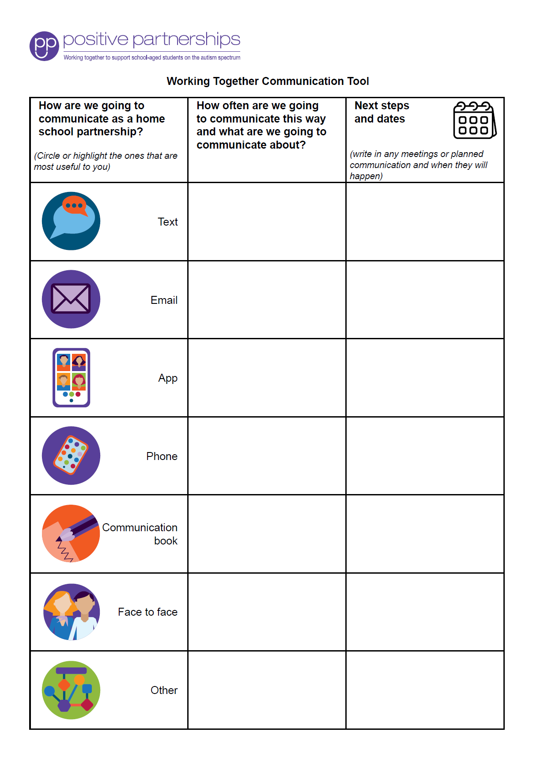
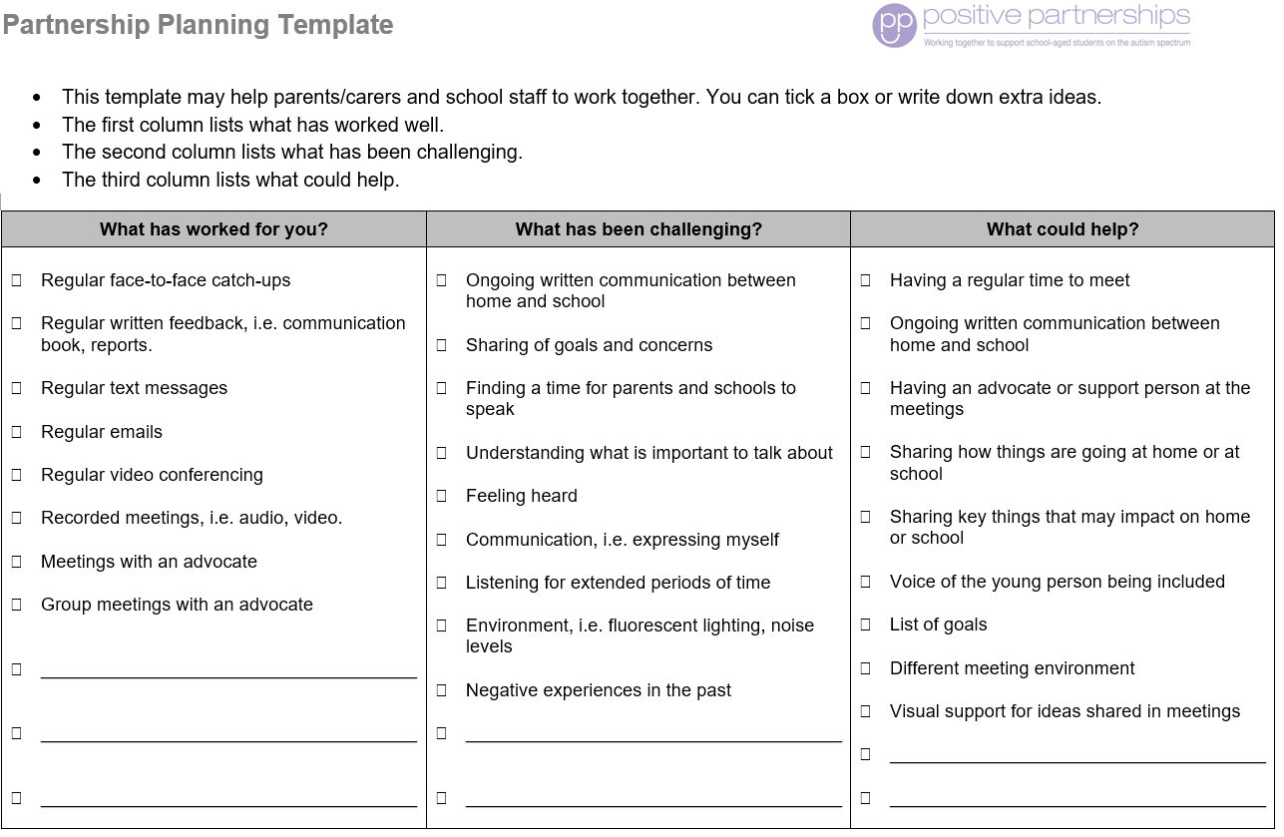
Partnership tools
Notes:
SUGGESTED TIME: 1 min · 3:08 - 3:09
PURPOSE
Demonstrate the Partnership tools and explain how they are used.
WHAT TO DO
1. Show the Partnership tools and explain how each is used.
2. Frame the tools as supports for consultation, not replacements for listening.
KEY MESSAGES
• Tools should support consultation rather than replace listening and student voice.

Slide 17
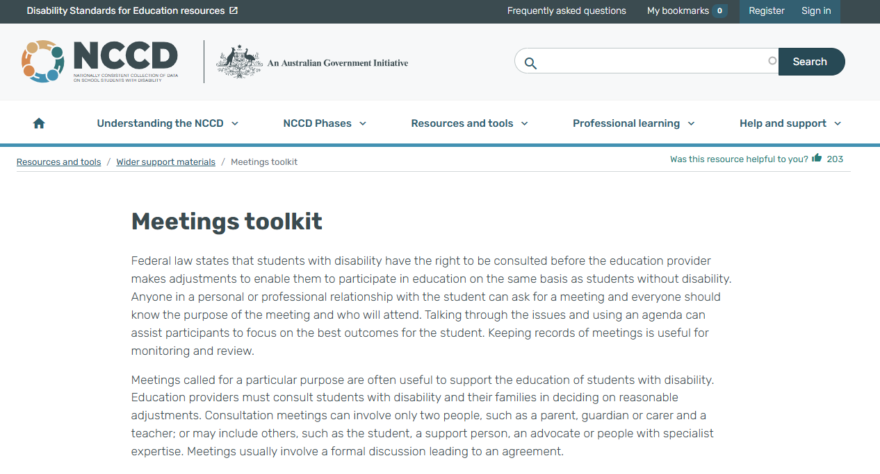
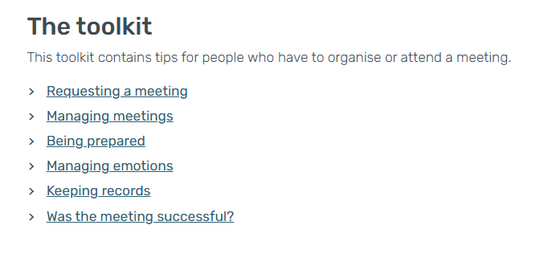
NCCD Meetings Tool Kit
The teacher and school use the Tool Kit to make the meeting purpose, consultation process, possible adjustments, evidence and next steps clear. Your observations and records of the support you give can be part of that evidence.
Notes:
SUGGESTED TIME: 1 min · 3:09 - 3:10
PURPOSE
Introduce the NCCD Meetings Tool Kit and direct participants to official NCCD information.
WHAT TO DO
1. Explain how the Tool Kit makes the meeting purpose, consultation process, possible adjustments, evidence and next steps clear.
2. Note that the teacher and school lead the NCCD process. Support staff observations and records of the support given can be part of the evidence the school keeps.
3. Remind participants to follow the processes used in their school or system.
4. Direct participants to official NCCD information.
KEY MESSAGES
• NCCD information must be current and official.

Slide 18
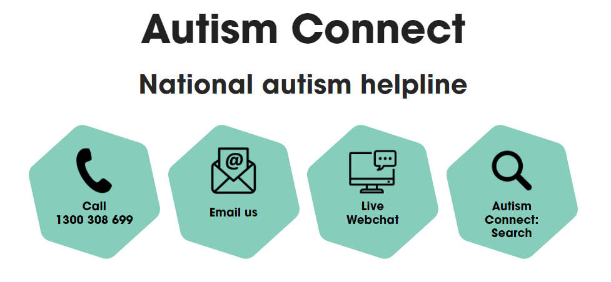


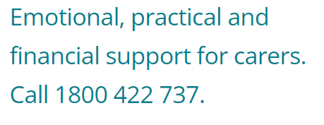

Other practical supports
Notes:
SUGGESTED TIME: 1 min · 3:10 - 3:11
PURPOSE
Introduce the support pathways included in the workshop.
WHAT TO DO
1. Briefly introduce the Positive Partnerships support options and other supports on the slide.
2. Point participants to Participant Guide p. 30 for resources.
KEY MESSAGES
• Introduce the Positive Partnerships support options included with the workshop.
KEEP IN MIND
• Check phone numbers and services are current before delivery.

Slide 19
Bridge to the next family conversation
Prepare for one purposeful conversation.
What needs to be understood?
What question will open the conversation?
How will the student's voice be included?
What can be decided together?
How and when will the school follow up?
Keep these notes for your conversation plan in Session 6.
Notes:
SUGGESTED TIME: 4 min · 3:11 - 3:15 · Participant Guide p.25 - Bridge to the next family conversation
PURPOSE
Identify the question and shared purpose participants will take into the Session 6 conversation plan.
WHAT TO DO
1. Ask participants to return to the students they support and the support they plan to fade.
2. Invite them to work through the prompts on the slide privately.
3. The conversation can be with a family or with the student. If it is with a family, ask participants to plan how the teacher will be part of it.
4. Keep the focus on preparation rather than scripting what the family should say.
5. Ask participants to carry one process change from the power reflection into the plan.
6. Preview the closing session on belonging, capacity, joy and practical next steps.
YOU MIGHT SAY
Keep these notes for your conversation plan in Session 6.
KEY MESSAGES
• Prepare for one purposeful conversation.
ACTIVITY: Private bridge reflection · on your own · 4 minutes
Prompt: Prepare for one purposeful conversation.
1. What needs to be understood?
2. What question will open the conversation?
3. How will the student's voice be included?
4. What can be decided together?
5. How and when will the school follow up?
Close: Keep these notes available for the conversation plan in Session 6.
THREAD
Connects to the Session 4 commit and 'My students' card ("I will talk with"), the warm handover on slide 6, and the conversation plan in Session 6 (Participant Guide p. 28).

